Slide 1
第十八組期末專題
楊敦富、徐凱瑞、蘇亭云

Slide 2
目錄
CARLA and RL 成果展示
其它
Omniverse Isaac with ROS2
Omniverse Jetbot RL training
總結

Slide 3

成果展示

Slide 4
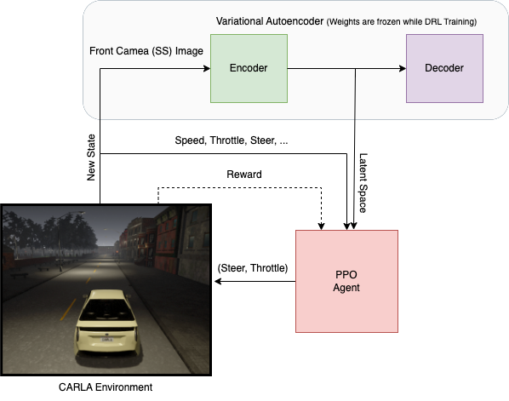
架構

Slide 5
期末專題製作過程
Omniverse Isaac with ROS2
Omniverse Isaac Jetbot
CARLA and RL
❌ 整合在一起

Slide 6
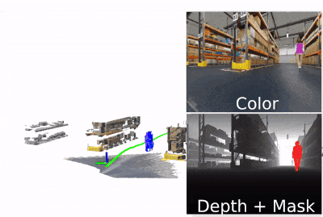
Omniverse ISAAC ROS2
Real-time processes depth, point cloud and camera image in 3D scene with Omniverse
使用 Omniverse 搭建場景、工廠機器車移動，透過 ROS2 輸出即時影像、深度圖片

Slide 7
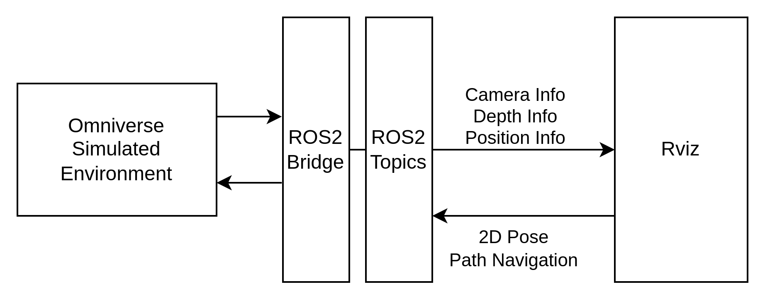


Omniverse ISAAC ROS2 整體架構

Slide 8
Omniverse ISAAC ROS2 目前結果展示

Slide 9
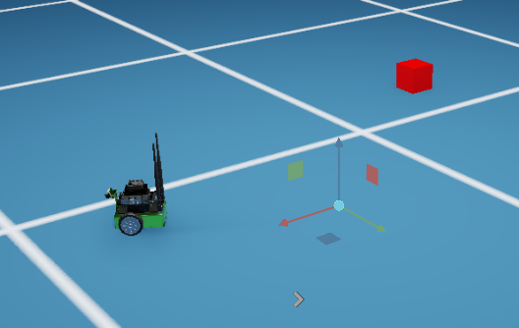
Omniverse Jetbot
透過強化式學習控制 Jebot 遙控車取得紅色方塊

Slide 10
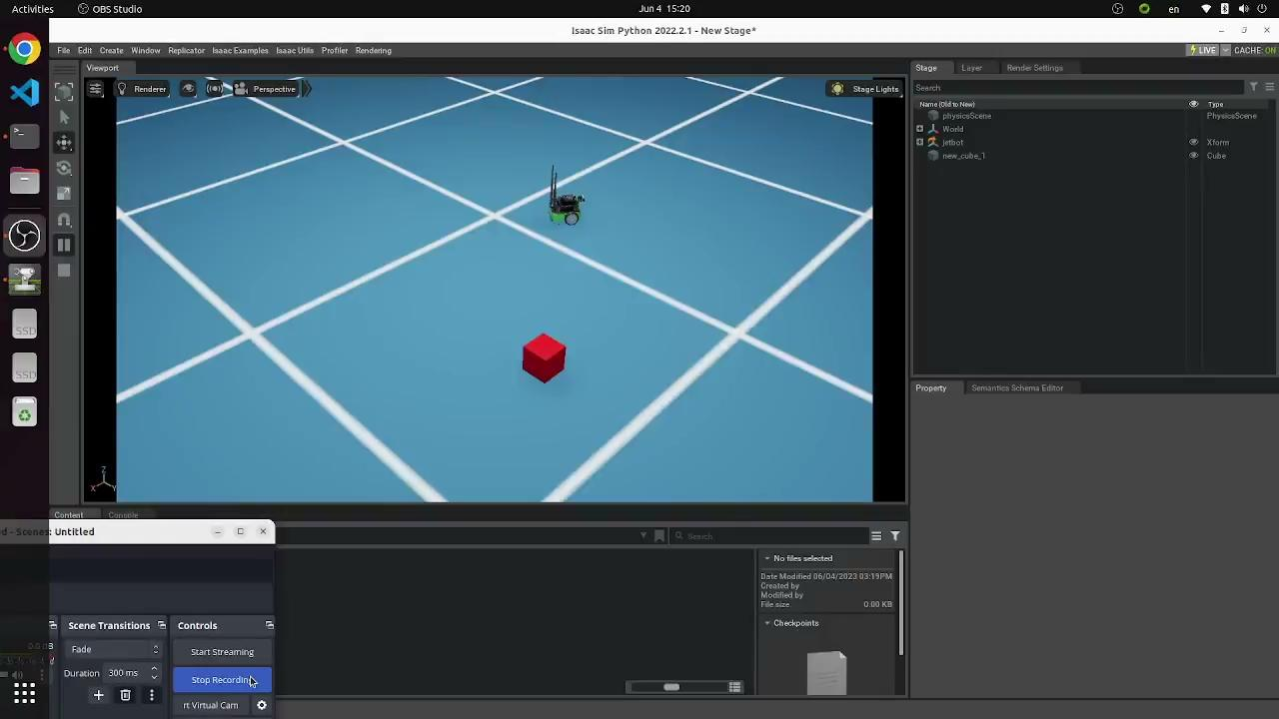
Omniverse Jetbot 成果展示

Slide 11
參考資料
GitHub - NVIDIA-ISAAC-ROS/isaac_ros_nvblox: Hardware-accelerated 3D scene reconstruction and Nav2 local costmap provider using nvblox
GitHub - idreesshaikh/Autonomous-Driving-in-Carla-using-Deep-Reinforcement-Learning
Jetbot Sample Applications - NVIDIA Docs

